Slide 1
Non-Linear Dimensionality Reduction: Variational Autoencoders
Mostafa Tavassolipour

Slide 2
Dimensionality Reduction
Dimensionality Reduction
Linear
PCA
LDA
Non-Linear
Autoencoders
T-SNE
Kernel PCA
LLE
Vanilla Autoencoder
Variational Autoencoder

Slide 3
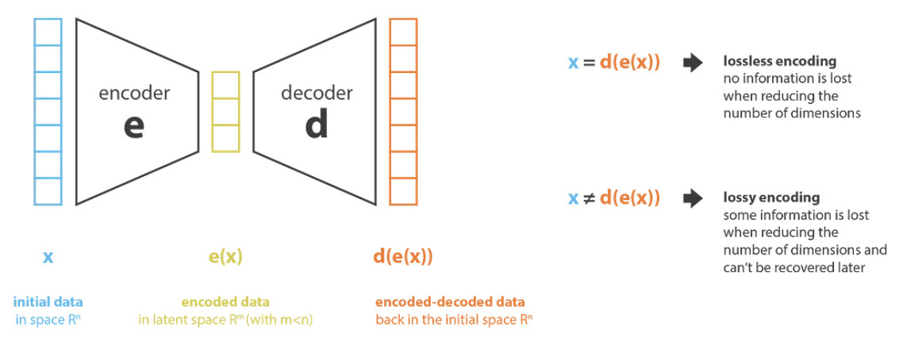
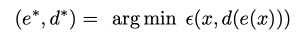
Dimensionality Reduction

Slide 4
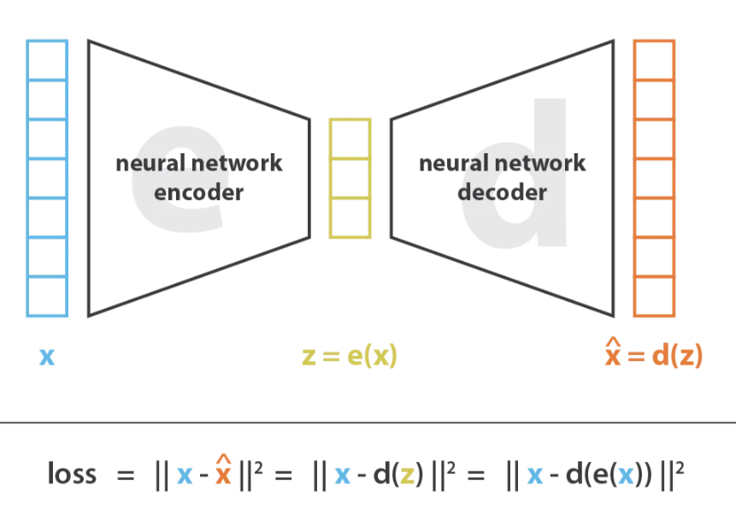
Autoencoder

Slide 5
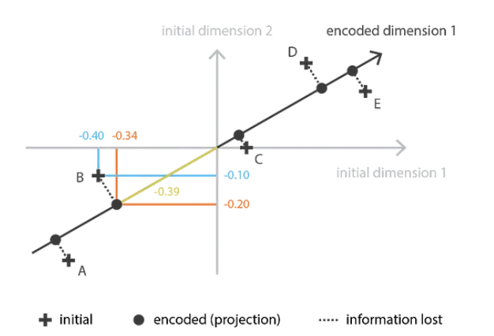
PCA

Slide 6
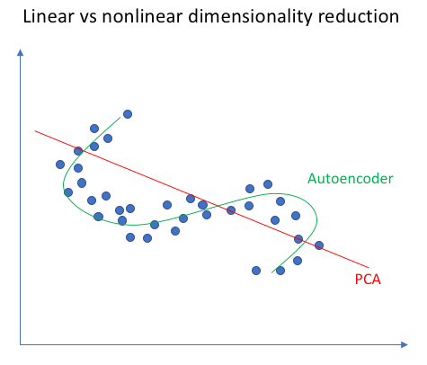
Autoencoder vs PCA

Slide 7
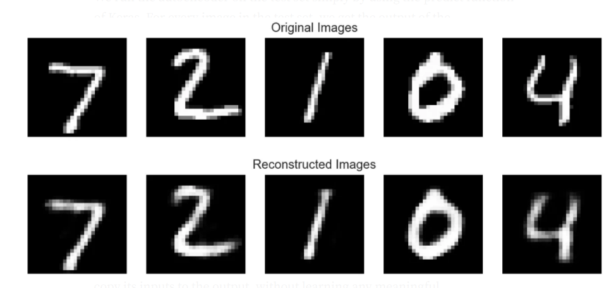
Autoencode on MNIST Dataset

Slide 8
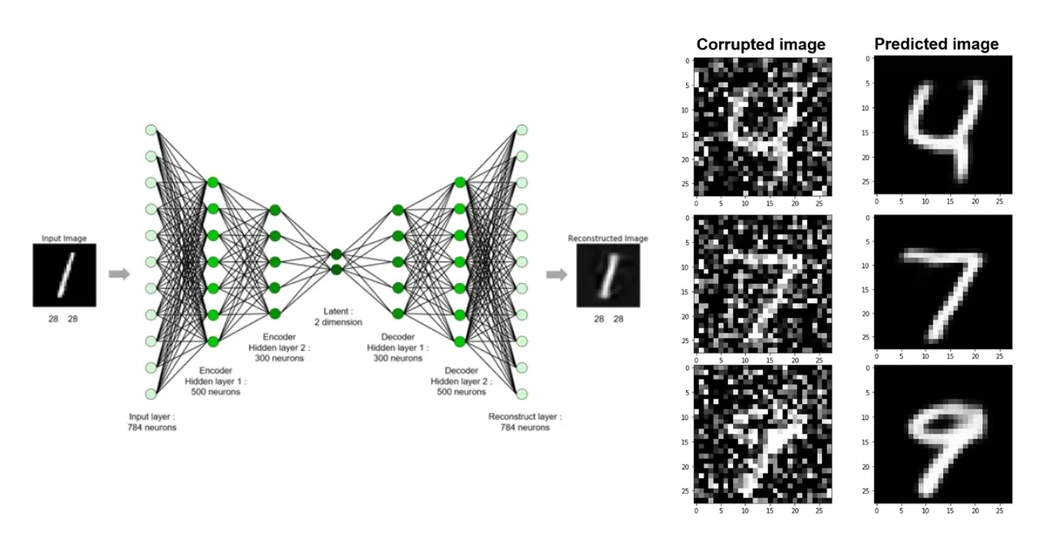
Denoising Autoencoder
Self-Supervised

Slide 9
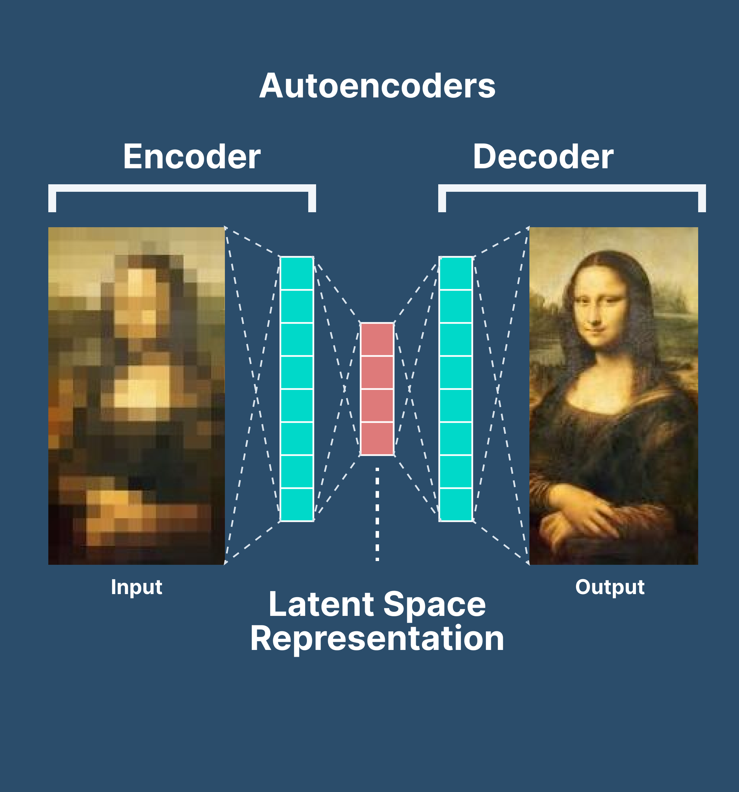
Super-Resolution using Autoencoder
Self-Supervised

Slide 10
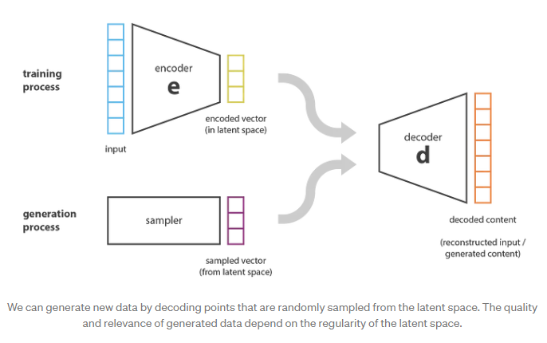
Limitations of Autoencoders for Generation

Slide 11
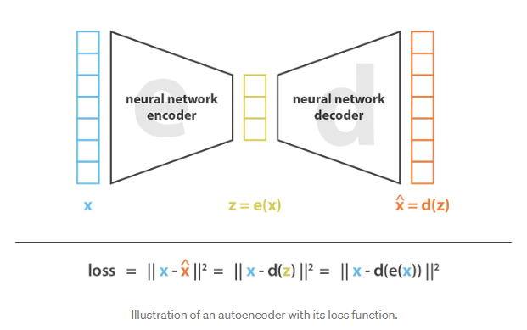
Autoencoders
IDEA: Setting an encoder and a decoder as neural networks

Slide 12
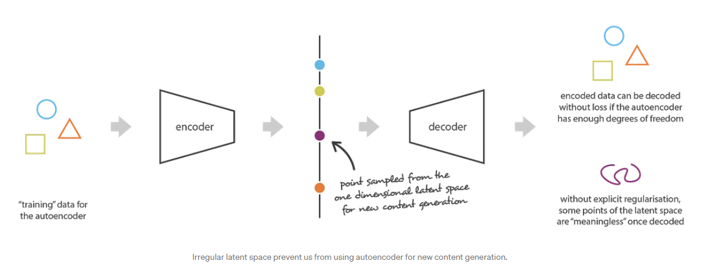
Sampling from Autoencoders
The autoencoder is solely trained to encode and decode with as few loss as possible, no matter how the latent space is organized.

Slide 13
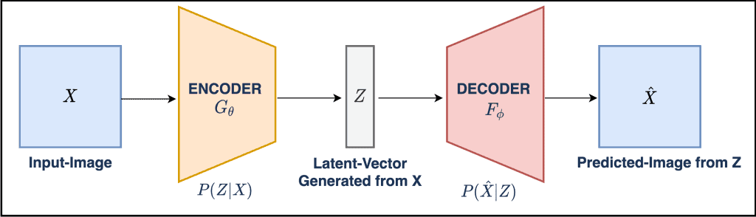
Variational Autoencoder
A variational autoencoder can be defined as being an autoencoder whose training is regularized to avoid overfitting and ensure that the latent space has good properties that enable generative process.
Encoding-decoding process: instead of encoding an input as a single point, we encode it as a distribution over the latent space.

Slide 14
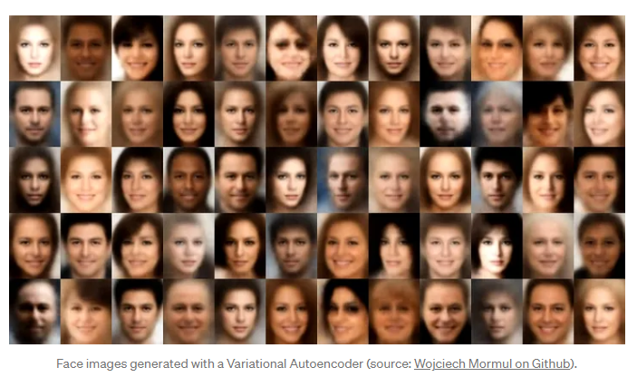
Variational Autoencoder

Slide 15
Training VAE
The input is encoded as a distribution over the latent space.
A point from the latent space is sampled from that distribution.
The sampled point is decoded and the reconstruction error can be computed.
Finally, the reconstruction error is backpropagated through the network.

Slide 16
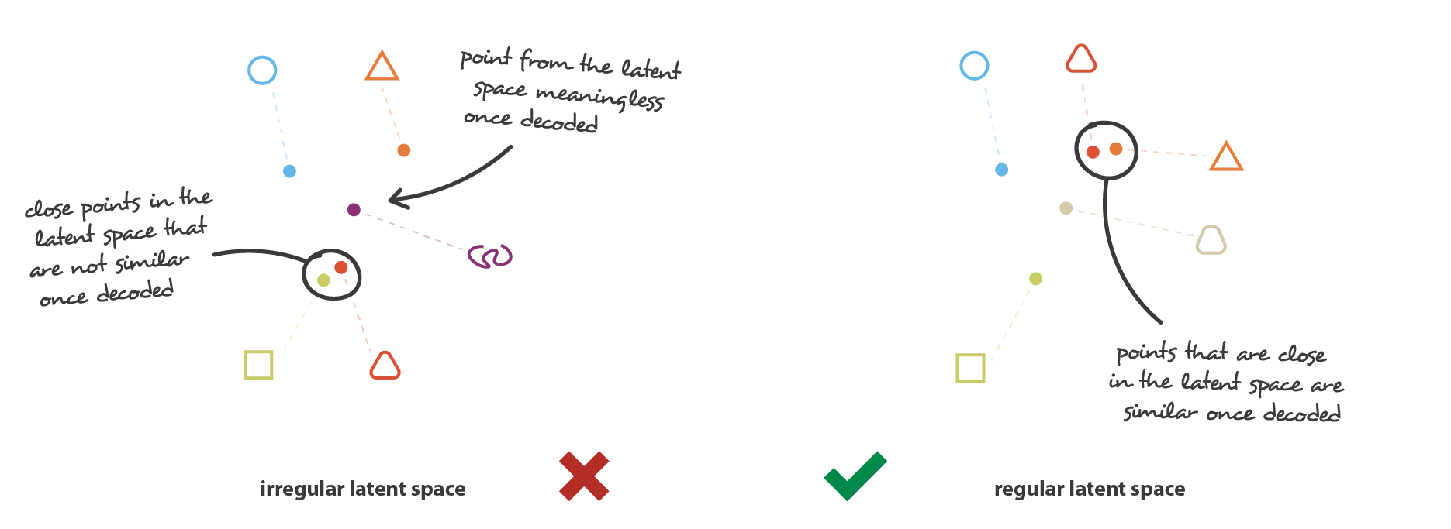
Regular Latent Space

Slide 17
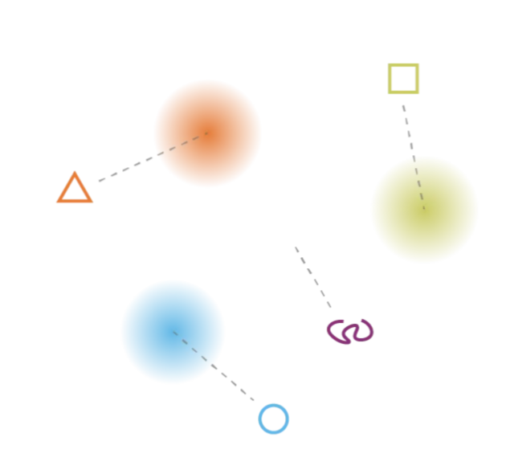
Variation Autoencoder: Latent Space

Slide 18
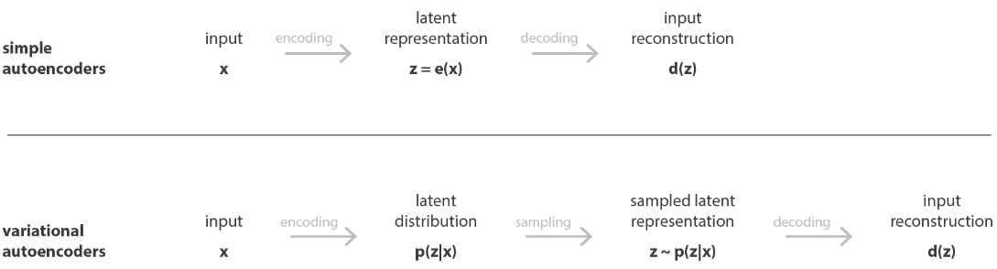
Autoencoder vs Variational autoencoder

Slide 19
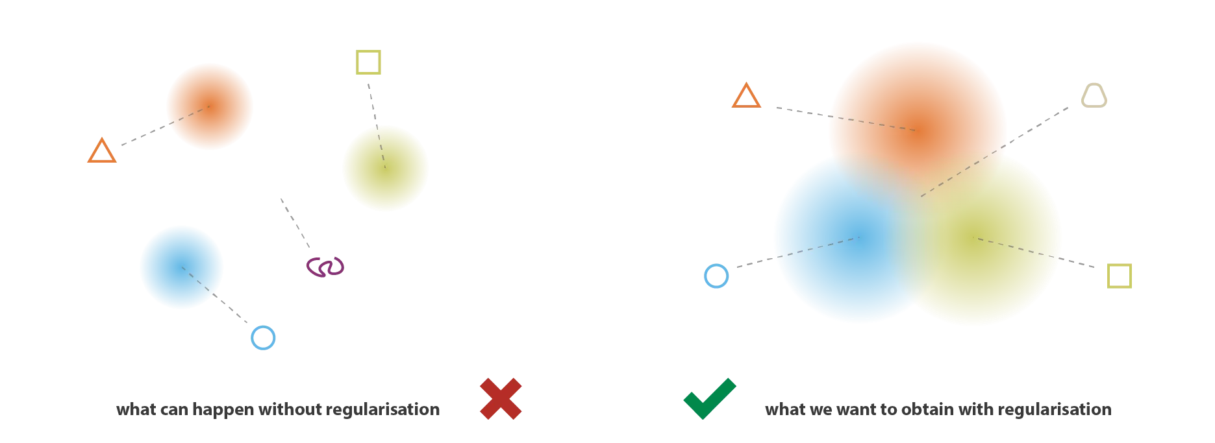
Regularized Latent Space

Slide 20
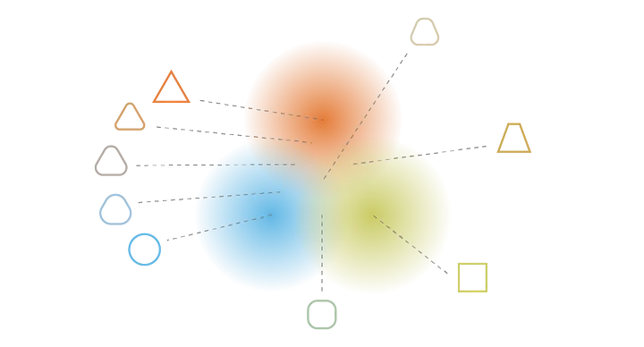
Gradient over Latent Space

Slide 21
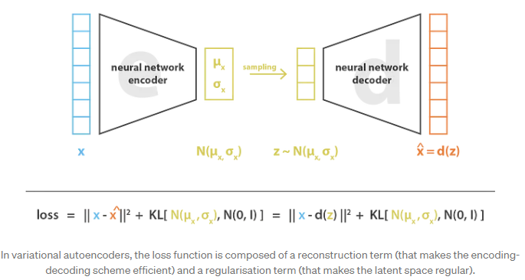
VAE: Loss Function

Slide 22
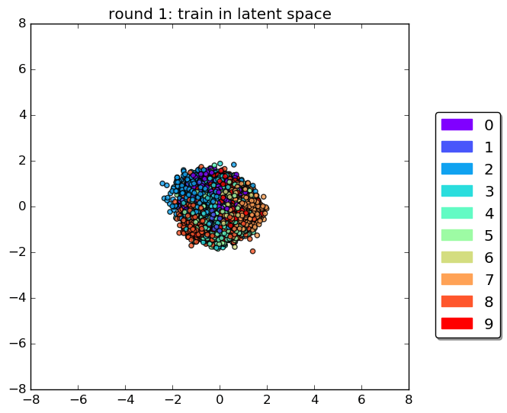
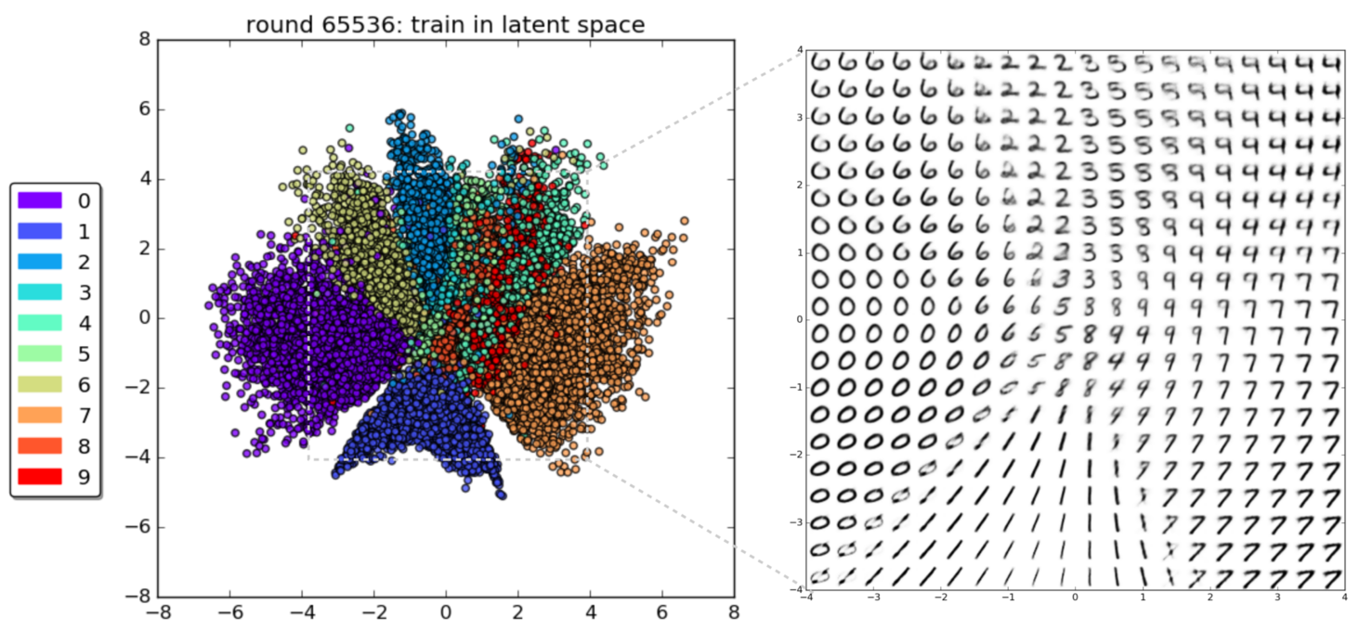
VAE on MNIST Dataset

